Slide 1
Human Interaction Development Using the Countess Quanta Robot
Brad Pitney
Yin Shi

Slide 2
Development Overview
Robot control software
Speech recognition
Gesture recognition
Person tracking
Music generation

Slide 3
Task Allocation
Brad
Developed robot control software.
Implemented person tracking.
Provided software support for gesture and speech recognition.
Fixed/tuned harp instrument.
Yin
Implemented speech recognition vocabulary.
Implemented gesture set for gesture recognition.
Configured motion/voice sequences.
Assembled arm extension for strumming.

Slide 4
Robot Control Software
Implemented using C#/WPF in Windows.
Utilizes Pololu’s recommended C# libraries.
Addresses limitations of existing servo control code.
Allows for easy integration of Kinect person tracking code developed last term.
Allows for speech and gesture recognition using Microsoft Kinect SDK.

Slide 5
Limitations of Previous Software
No GUI, limited console control.
No control over servo speed or acceleration.
No monitoring of servo move limits or timing.
Motions defined as cryptic strings, e.g.:
%10_1670_5%%10_1535_10%%10_1400_15%%

Slide 6
Key Features of New Software
Integrates Kinect audio and visual inputs.
Configures and manages servo controller.
Organizes servo moves as a sequence of frames.
Stores move sequences and servo configurations in human-readable xml files.
Simple GUI for testing and displaying system status.
Versatile logging system.

Slide 7
Kinect Management
Based on example code from Microsoft’s Kinect Developer Toolkit.
Supports speech recognition logic.
Provides skeleton data for gesture recognition and person tracking.

Slide 8
Servo Controller Management
Initializes and controls servos through Pololu C# library.
Bounds position and speed of each servo within configurable limits.
Monitors servo moves and logs a warning if servo does not reach destination within expected time.
Flexible configuration through human-readable xml file.

Slide 9
Servo Controller Management
<Servo>
<index>0</index>
<name>Wrist left/right</name>
<positionLimitMin>700</positionLimitMin>
<positionLimitMax>2300</positionLimitMax>
<speedLimitMin>10</speedLimitMin>
<speedLimitMax>1000</speedLimitMax>
<defaultPosition>1400</defaultPosition>
<defaultSpeed>20</defaultSpeed>
<defaultAcceleration>0</defaultAcceleration>
</Servo>

Slide 10
Motion Sequences
Roughly based on Pololu Sequencer.
Groups and synchronizes multiple servos.
Each Sequence consists of a list of Frames.
Each Frame can contain:
Move commands for multiple servos.
A speech synthesizer command.
A time delay.

Slide 11
Motion Sequences
Servo speeds are automatically scaled using a Frame’s TimeToDestination attribute.
All servo moves complete at the same time.
Avoids needing to manually set speeds for each servo.
Sequences are used by gesture/speech recognition code and in music generation.
While a Sequence is running, the system ignores other Sequence commands and suspends person tracking.
Sequences are stored in a human-readable xml file.

Slide 12
Motion Sequences
<Sequence Name=“Example Sequence">
<Frame TimeToDestination="1" Speech="Testing one two three“>
<ServoPosition Index="0" Position="800" />
<ServoPosition Index=“1" Position=“1200" />
</Frame>
<Frame TimeToDestination="0.5“ Delay=“2”>
<ServoPosition Index="0" Position="2200" />
<ServoPosition Index=“1" Position=“1000" />
</Frame>
</Sequence>

Slide 13
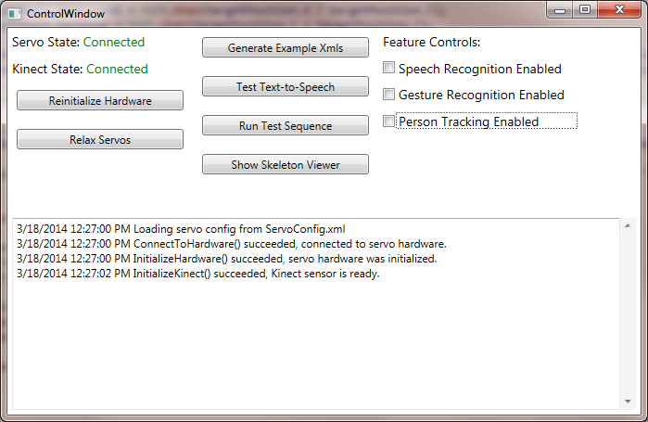
GUI

Slide 14
Error Logging
Displays time-stamped log messages in the UI.
Can filter based on severity of message.
Configurable limit on how many messages are stored.

Slide 15
Speech Recognition
Based on ‘Speech Basics-WPF’ example application from Kinect Developer Toolkit.
Recognizes a vocabulary of words/phrases, and executes specified Sequences.
System disables speech recognition while speech synthesis is running, to prevent the robot from responding to its own words.

Slide 16
Gesture Recognition
Based on ‘Skeleton Basics-WPF’ example application from Kinect Developer Toolkit.
Recognizes a vocabulary of skeleton joint positions and relationships, and executes specified Sequences.
Logic is currently limited to single frame ‘poses’.

Slide 17
Person Tracking
Based on person tracking software developed last term.
Robot turns head/eyes to follow a person tracked by the Kinect.
Supports horizontal and vertical head motion, and eye motion.

Slide 18
Music Generation
Repaired strings and tuned harp instrument.
Designed and assembled arm extension for strumming the instrument.
Worked on creating and testing strumming motion sequences.

Slide 19
Music Generation
Encountered Issues:
Some servos have trouble lifting extra weight from arm extension.
Strumming motion sometimes gets stuck on strings.
Motion is not always repeatable.
Arm oscillates after motion, which affects the next motion.
Position of hardware may change slightly.

